Slide 1







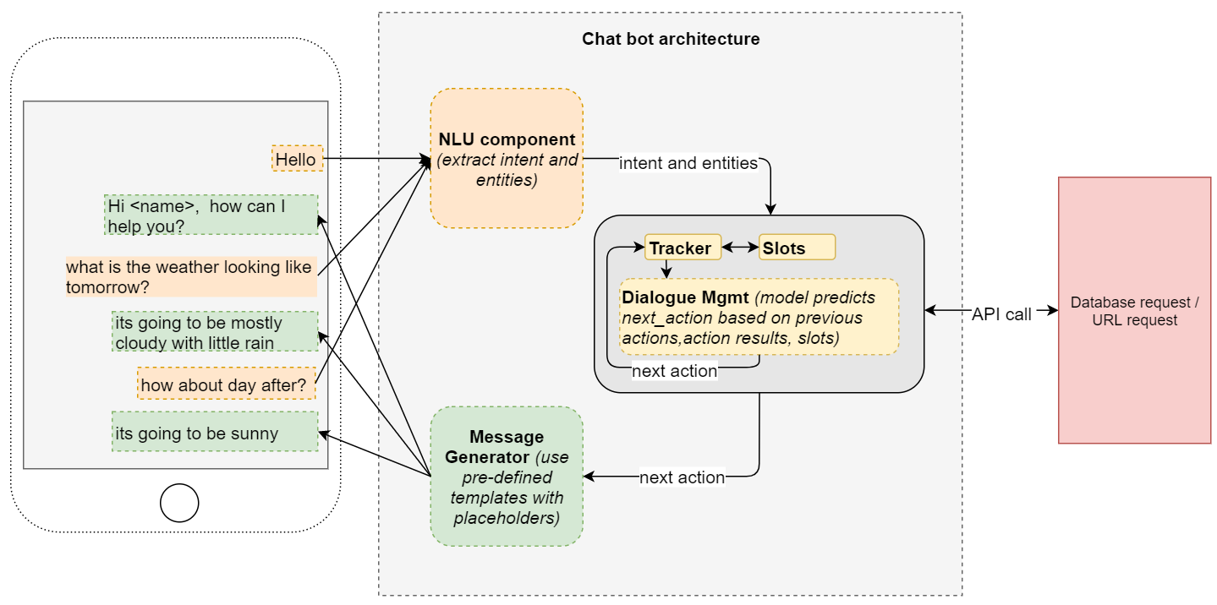
Cloud-based Conversational AI Interfaces
Presented by
Yuchen Wang
Why?
With AI technologies emerging rapidly, the market size of Public Cloud Platforms was predicted to increase by 40% 2020-2022, with the worldwide market revenue of Chatbots being $2 billion in 2024. Faced with half of the businesses being uprepared for this revolution, this project is trying to help organizations plan, build and implement interactive conversational bots to achieve a better customer/clients service.
What?
A Cloud-based Conversational AI Interface can enable organizations to create customized conversational applications, including chatbots, voicebots and IVR (Interactive Voice Response) bots, across all their platforms and channels. Built on public cloud platforms, it will provide built-in integration with the power of other cloud technologies, such as security, authentication and development. With the help of cloud computation and cloud storage, the interfaces are designed for more accurate and faster recognition and responses.
How?
1. Evaluation
2. Optimization
v.s. v.s.
Chatbot Market Revenue Worldwide
Public Cloud Services Market Size
References: https://www.statista.com/statistics/966893/worldwide-chatbot-market-value/;
https://www.statista.com/statistics/273818/global-revenue-generated-with-cloud-computing-since-2009/;
https://www-statista-com.proxy.lib.uwaterloo.ca/chart/19134/cloud-vendor-use/

Slide 2
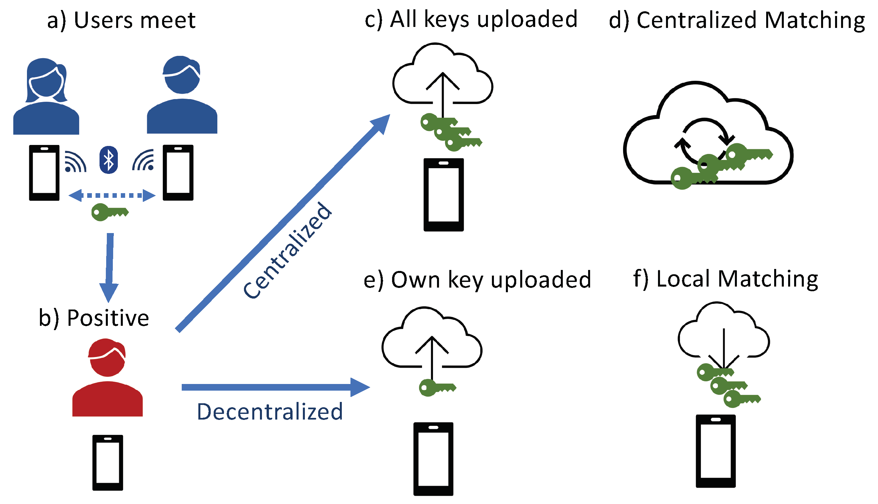
Face Recognition w/o Privacy Invading
Presented by
Yuchen Wang
Why?
With the rapid development of Artificial Intelligence, automated biometric technologies seem to be more applicable and beneficial in both public and private sectors. Among all the identification technologies, facial recognition is acknowledged to be the most highly invasive one, since the subject doesn’t need to give consent or even participate knowingly.
While Facial Recognition has become a viable and increasingly accurate technology through more pervasive digital images, cheap data storage and common online photo sharing, public has been worried about if their privacy and security can be protected. According to an ARM study, 71% of consumers are concerned about a greater privacy risk caused by AI technologies, while only about 40% of organizations are prepared for major AI issues: Transparency, Ethic, Personal Data and Cybersecurity, shown by a study of Deloitte.
What & How?
Two-thirds of people think AI and Facial Recognition should only be used under certain circumstances and strict regulations, according to a research by Ipsos, but it is hard for governments and companies to make appropriate regulations around what it can be used for and by whom.
What are people’s real pain points and how can we improve our model accordingly? Whether there is an alternative algorithm that can avoid privacy to be invaded and ensure accuracy and security? These are the topics this project is about to cover.
1. Public Response Analysis
2. Model Improvement
3. Alternative Algorithm Development
Consumers concern that AI technologies expose them to greater privacy risk, 2019
Inspiration of Covid Tracking System
References:
https://www-statista-com.proxy.lib.uwaterloo.ca/statistics/1104058/facial-recognition-in-stores-perception-mismatch-of-retailers-and-consumers-by-country-worldwide/
https://www-statista-com.proxy.lib.uwaterloo.ca/statistics/1064268/opinion-use-artificial-intelligence-and-facial-recognition-to-maintain-order-belgium/

Slide 3



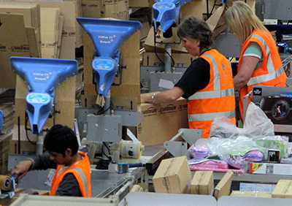
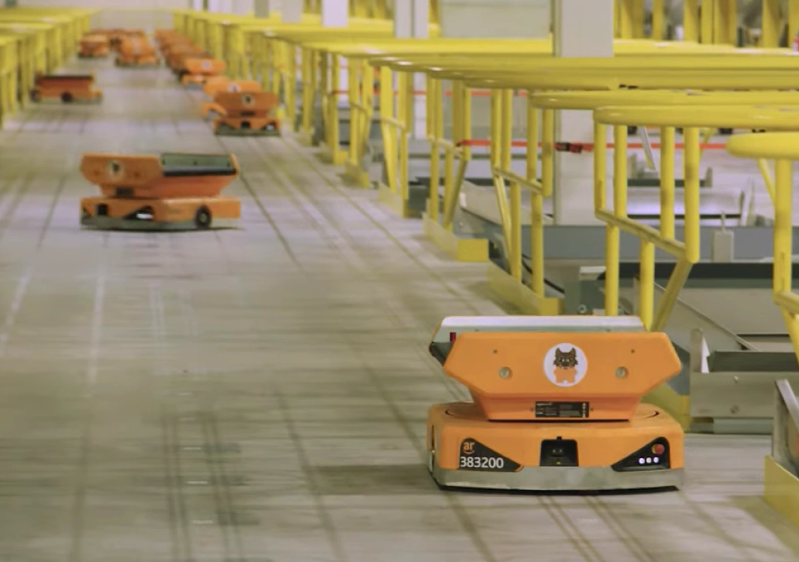
Robotic Automation in Distribution Centers
Presented by
Yuchen Wang
Why?
With E-commerce continuously booming up worldwide and global supply chain networks connected closer, the logistics industry has shown an increasingly importance for governments, businesses and consumers. Due to Covid-19, people have been heavily relying on online shopping and logistics distribution, while contactless technologies are badly lagging in distribution centers and warehouses by which many outbreaks were caused and concerns were raised.
During recent years, there has been a surge of demand for robotic automation in industries, including supply chain and logistics. The market size of logistics automation was predicted to grow by 107% from 2020 and achieve $81 billion in 2025. This project is not only to leverage robots to resort and examine packages in the warehouses, but also to enable automatic scheduling, quality assurance and contingent planning in distribution centers using AI (Artificial Intelligence) and UI (User Interaction Techniques).
What & How?
Distribution
Center
Physical
Carriage
Planning & Scheduling
Analyzing & Reporting
Quality
Assurance
Real-time Processing Center
Management
Team
Customer
Service
References:
https://www-statista-com.proxy.lib.uwaterloo.ca/outlook/243/100/ecommerce/worldwide
https://www-statista-com.proxy.lib.uwaterloo.ca/statistics/1099087/logistics-automation-market-size-worldwide/

